Slide 1

Team-3 Rohith Bhogaraju Nehal Mahankali Varsha Hunjan Manasa Sai Kalavakuri Sunil Chinthaparthi Vaseem Syed Mohammed Shaik Zaheer Rohit Rathod Sakshi Singh Venkat Sanjay

Slide 2
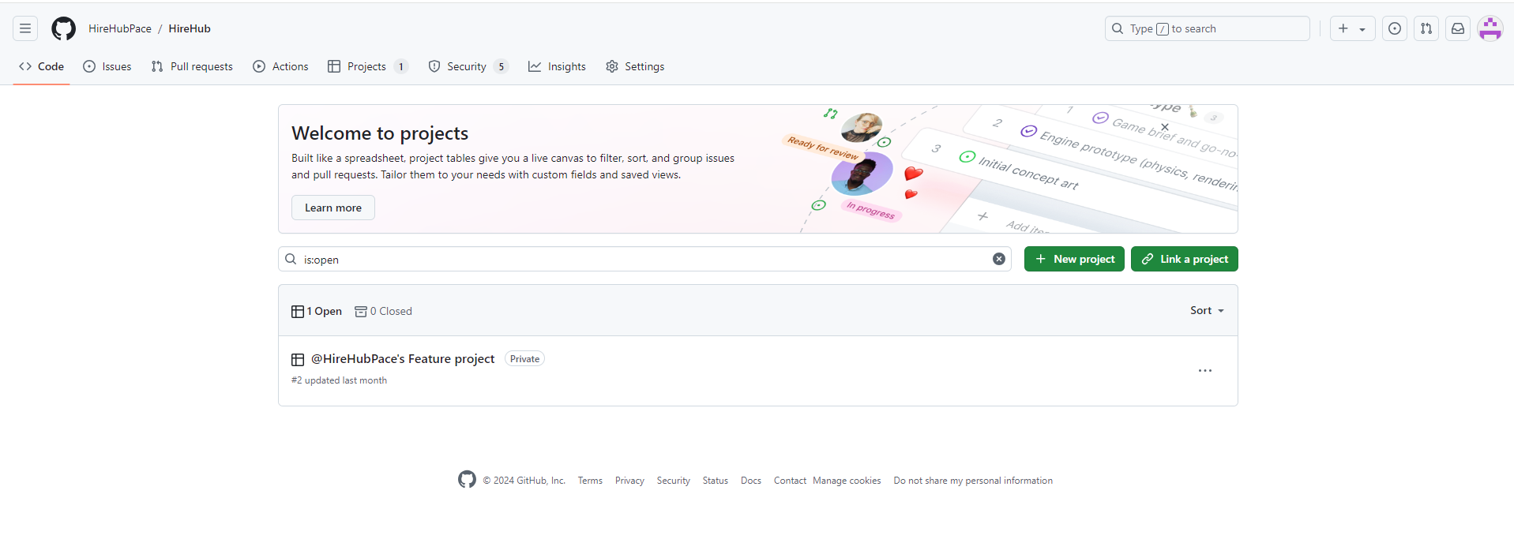
1. Welcome to HireHub Git Repository
Introduction to HireHub private project hosted on GitHub.
Git repository is used for version control.
Private project to ensure only authorized access.

Slide 3
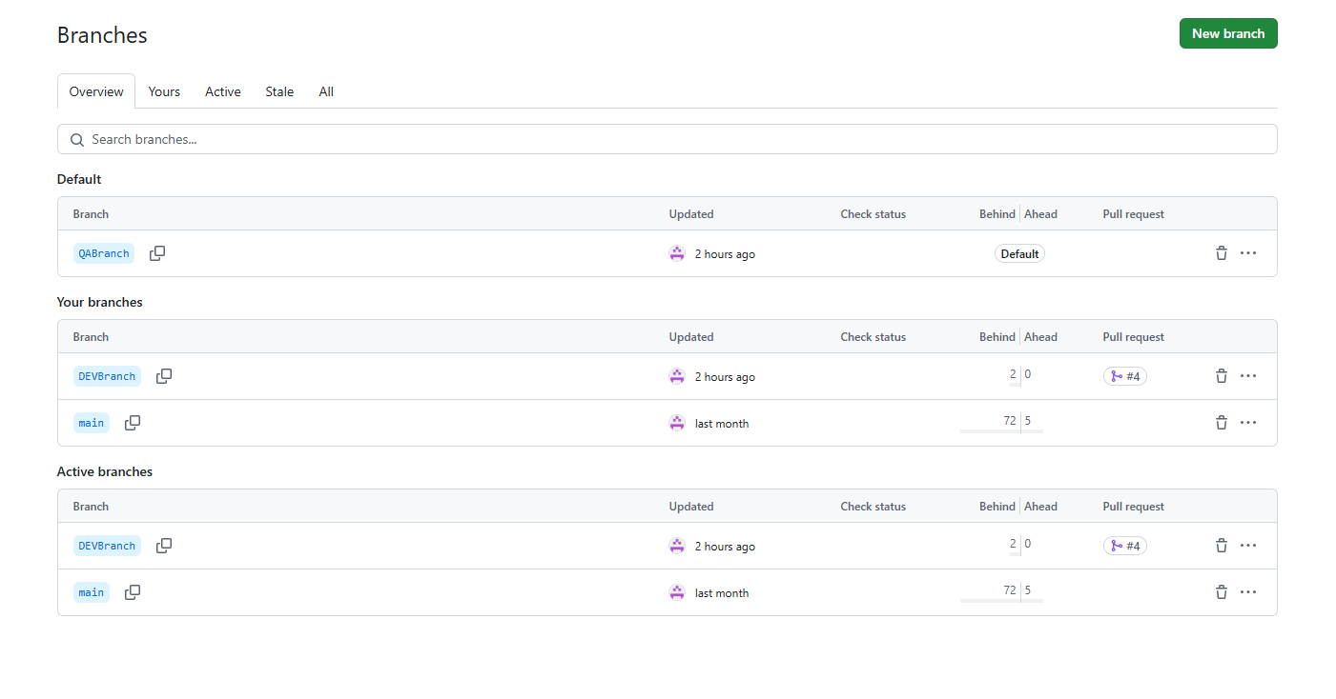
2. Branch Structure
Main: Production-ready code.
DEVBranch: Active development happens here.
QAbranch: Used for testing and quality assurance.
Each branch has a defined role to ensure smooth development flow.

Slide 4
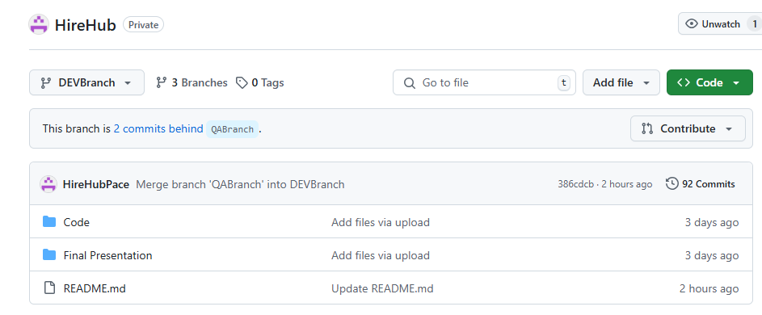
3. Repository Structure
Git clone link provided for sharing the repository:
https://github.com/HireHubPace/HireHub.git
Developers clone this branch for stable, production-level code.
It holds the final version of the app, ready for deployment.

Slide 5
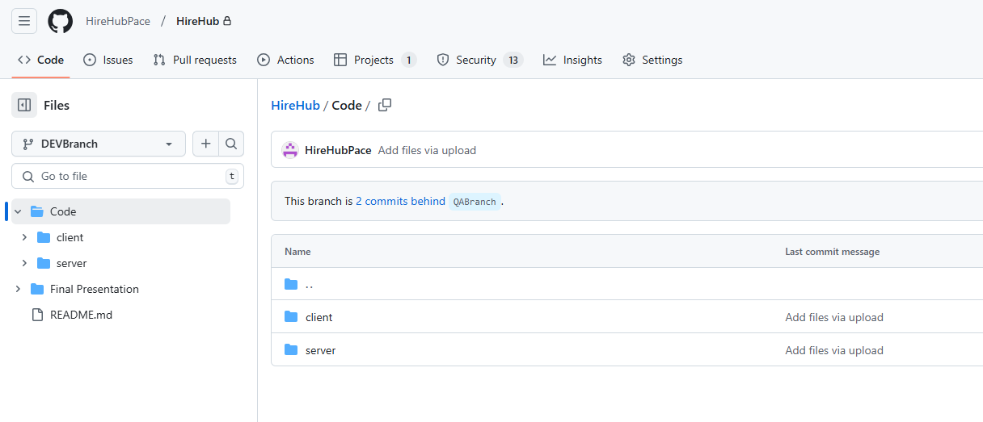
4. HireHub/Code – (client + server)

Slide 6
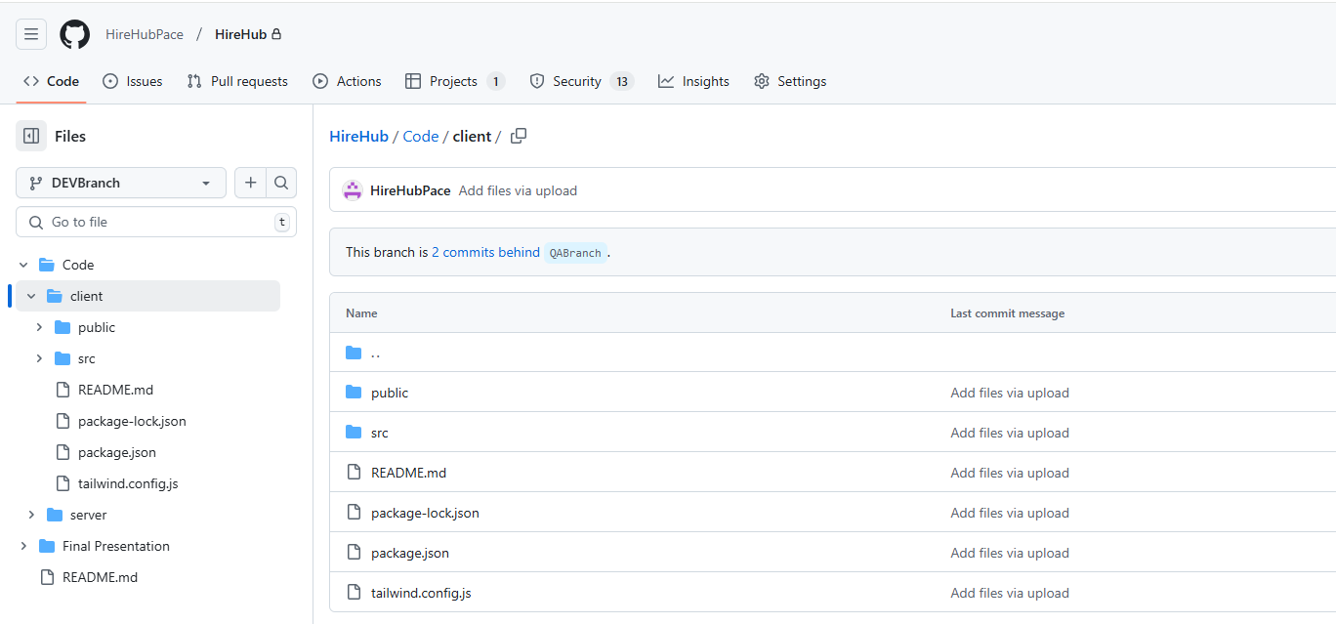
5. HireHub/Code/client
Client (Frontend) contains all critical project files and Key config files such src, package.json,tailwind.config.js.

Slide 7
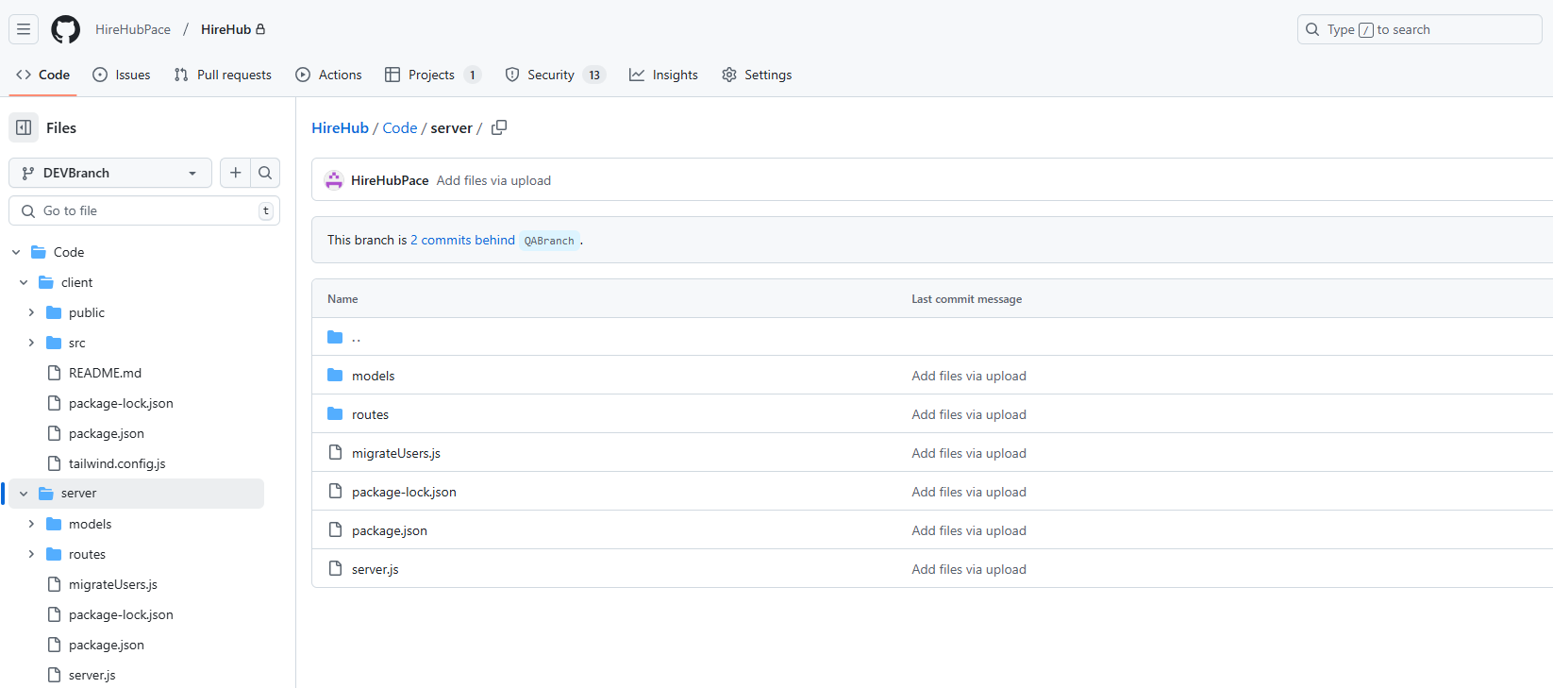
6. HireHub/Code/server
Server (Backend) contains server-side logic and Key files server.js, user.js and migrateUsers.js

Slide 8
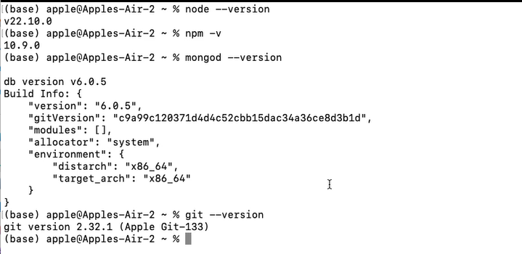
7. Pre-requisites in Local System for HireHub

Slide 9
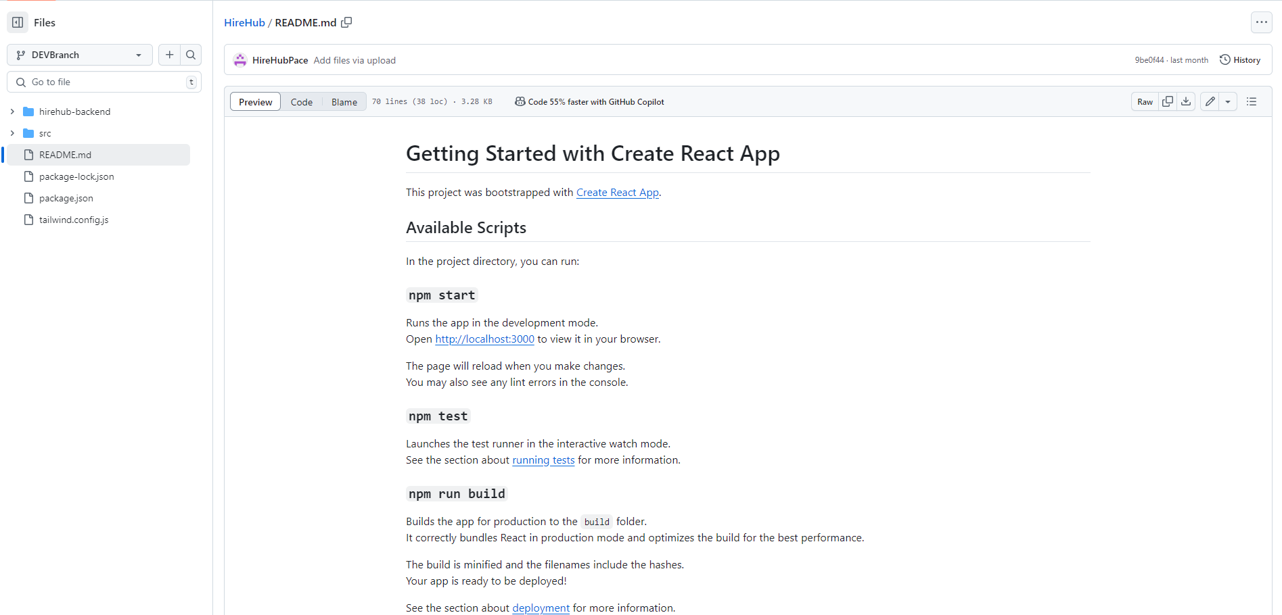
8. Installation Steps and README Overview
Clone the git repo using the link
npm start: Run the app in development mode at localhost:3000
node server.js: Connect to MongoDB, server running on port 4000
npm test: Launches test runner for debugging.
npm run build: Builds the app for production.

Slide 10
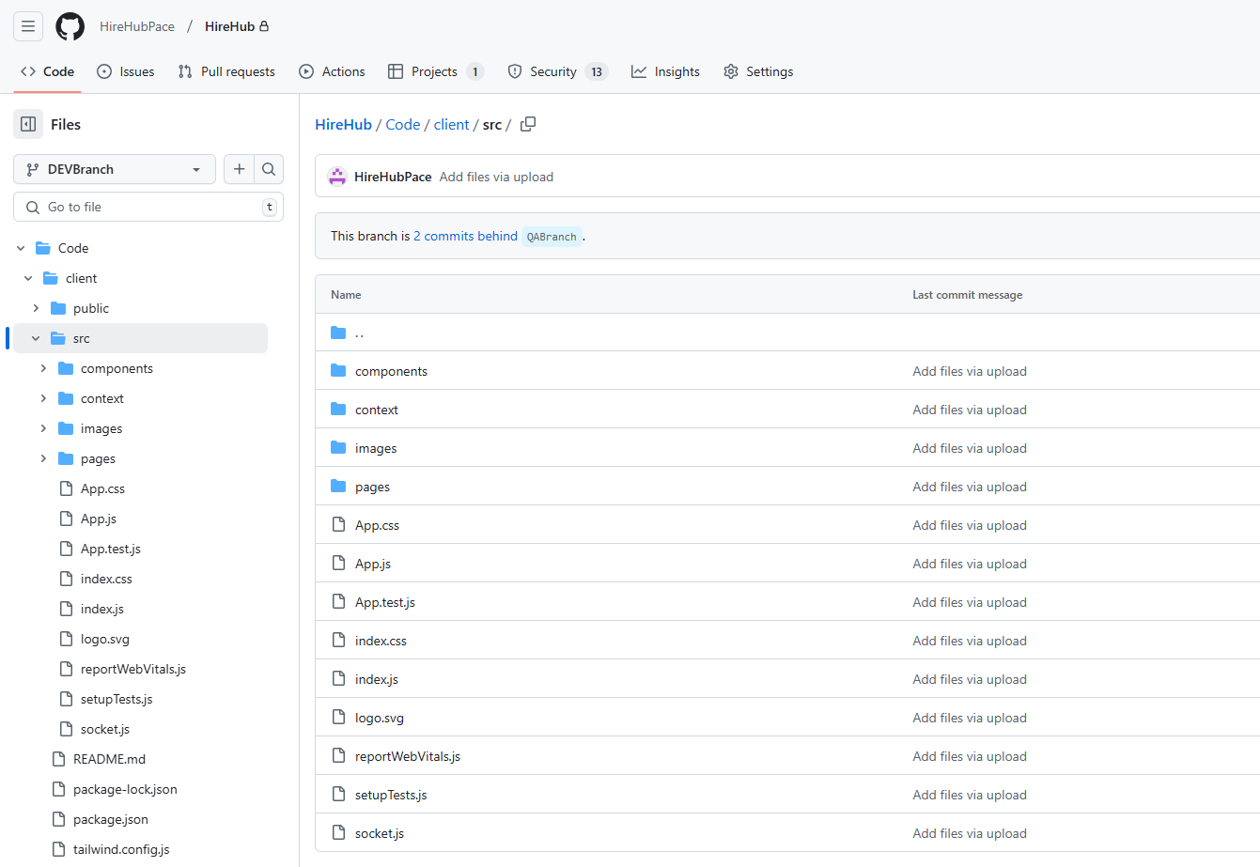
9. Frontend Source Files in HireHub (client)

Slide 11
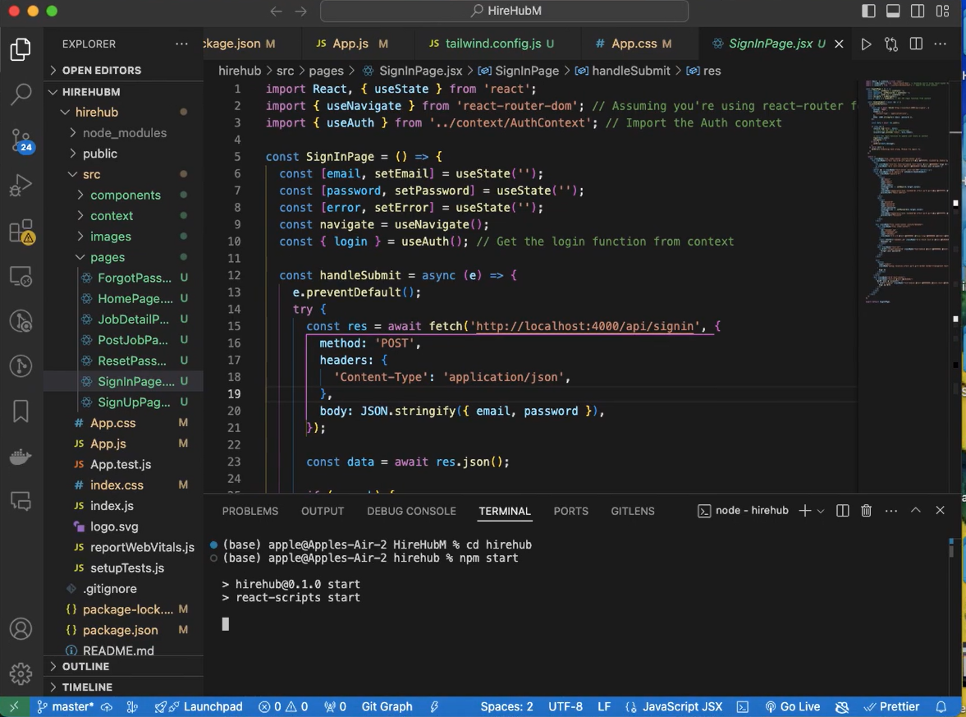
10. Client (DEVBranch) Running Locally

Slide 12
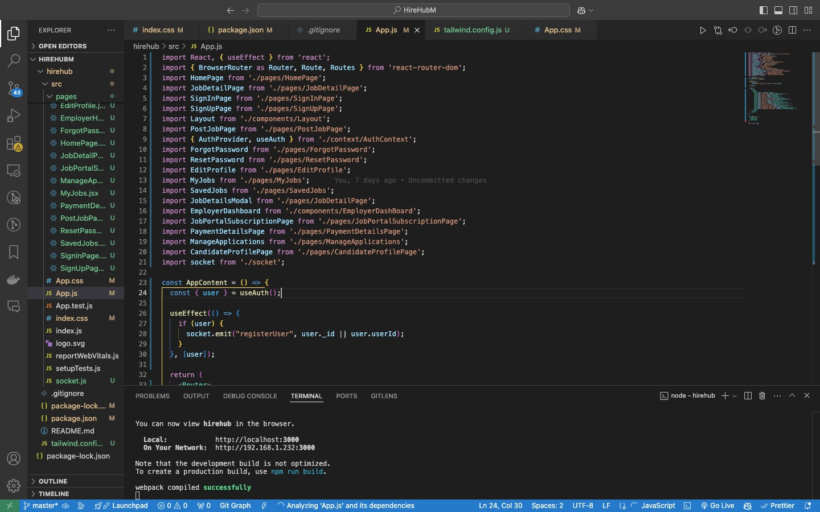
11. Client (DEVBranch) – app.js Config

Slide 13
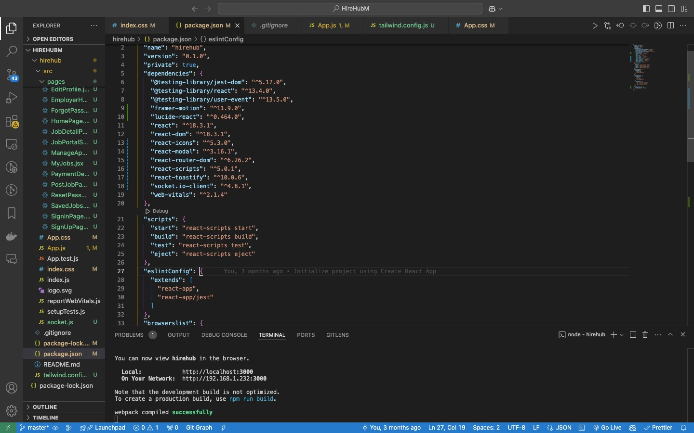
12. Client (DEVBranch) – package.json Dependencies

Slide 14
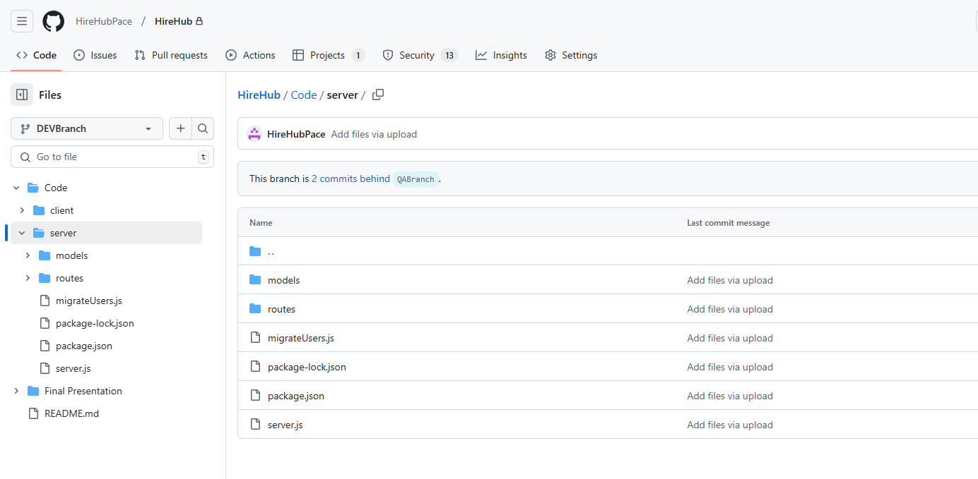
13. Backend Source Files in HireHub (server)

Slide 15
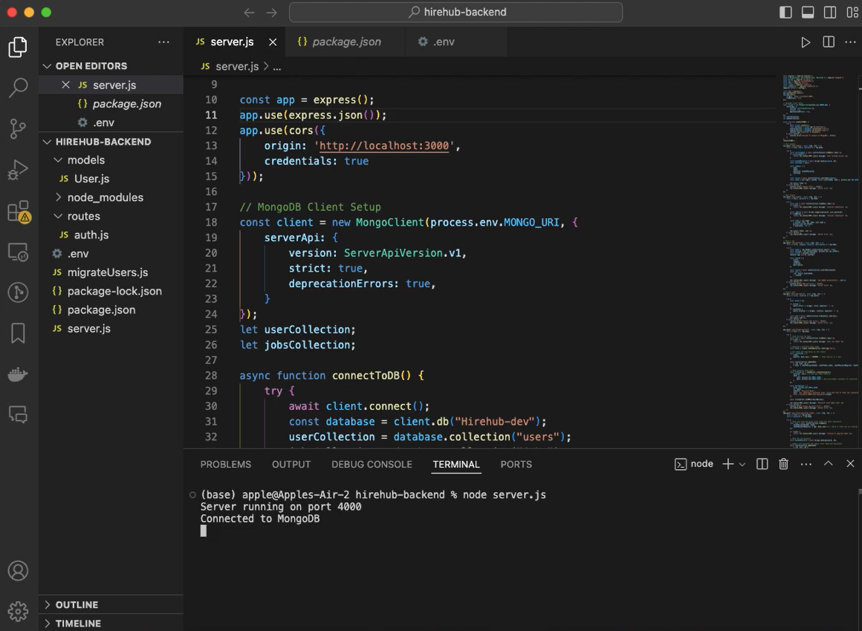
14. Server (DEVBranch) Running Locally

Slide 16
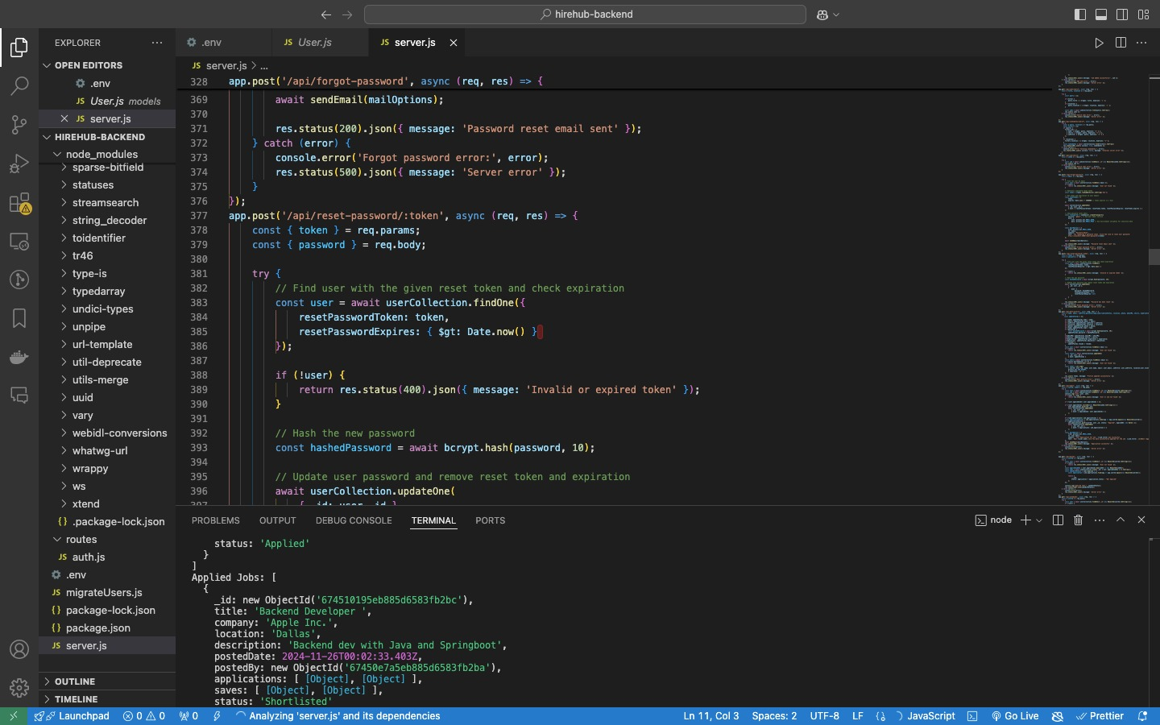
15. Server (DEVBranch) – server.js Config

Slide 17
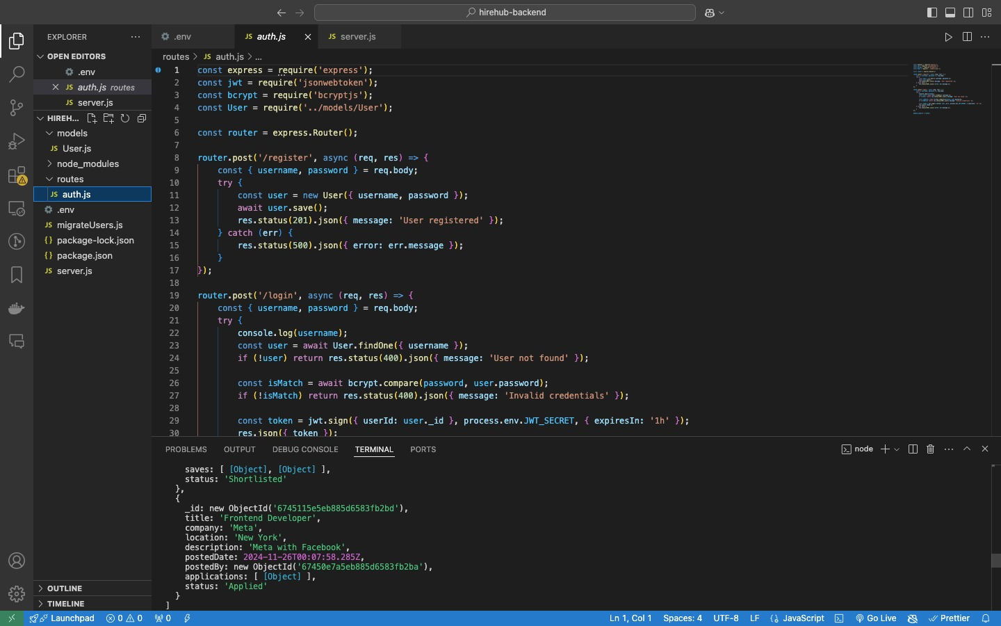
16. Server (DEVBranch) – auth.js Config

Slide 18
Thanks for your attention!

